Slide 1

Internet of Things
UPM E.U.I.T. Diatel
Xi Chen scotor317@gmail.com

Slide 2
Contents of Introduction
1
What’s Internet of Things
2
State of the Art of IoT
3
Challenges and Limitation of IoT
4
Future of IoT
Notes:
1. What’s IoT part includes the Definition of IoT, the history of IoT, the features of IoT, why IoT, and at last propose different application scenarios of IoT to better recognize it.
2. In the State of the Art part, I would firstly introduce several enabling technologies of IoT and also more detail about the wireless sensor network and IPv6 of IoT, on which are what we focus now. Then the ongoing research project and research groups, universities and companies will be mentioned. At last, the economic system and overall diagram of marketing and R&D of IoT will be discussed.
3. In this part, two main challenges and several other challenges of IoT will be discussed and also the limitation of IoT will be preliminarily proposed.
4. The last part is the Future of IoT, I will discuss the areas which will potentially be implemented by IoT, and also the open issue of IoT. At last, I will discuss about the future technologies that may be affect the development of IoT.

Slide 3
What’s the Internet of Things
Definition
(1) The Internet of Things, also called The Internet of Objects, refers to a wireless network between objects, usually the network will be wireless and self-configuring, such as household appliances.
------Wikipedia
(2) By embedding short-range mobile transceivers into a wide array of additional gadgets and everyday items, enabling new forms of communication between people and things, and between things themselves.
------WSIS 2005
Notes:
WSIS: World Summit on the Information Society, it’s a pair of conference about information society

Slide 4
What’s the Internet of Things
Definition
(3) The term "Internet of Things" has come to describe a number of technologies and research disciplines that enable the Internet to reach out into the real world of physical objects.
------IoT 2008
(4) “Things having identities and virtual personalities operating in smart spaces using intelligent interfaces to connect and communicate within social, environmental, and user contexts”.
-------IoT in 2020
Notes:
The semantic origin of the expression is composed by two words and concepts: “Internet” and “Thing”, where “Internet” can be defined as “The world-wide network of interconnected computer networks, based on a standard communication protocol, the Internet suite (TCP/IP)”, while “Thing” is “an object not precisely identifiable” Therefore, semantically, “Internet of Things” means “a world-wide network of interconnected objects uniquely addressable, based on standard

Slide 5
What’s the Internet of Things
History
1997, “The Internet of Things” is the seventh in the series of ITU Internet Reports originally launched in 1997 under the title “Challenges to the Network”.
1999, Auto-ID Center founded in MIT
2003, EPC Global founded in MIT
2005, Four important technologies of the internet of things was proposed in WSIS conference.
2008, First international conference of internet of things: The IOT 2008 was held at Zurich.
Notes:
Auto-ID Center focus on EPC-IOT, EPC is Electric Product Code, It’s a family of coding schemes created as a low-cost method of tracking goods using RFID Technology, it generated Auto-ID Lab and EPCGlobal, former one is to do R&D and second one is to set standard and run marketing.
Four important technologies are nano tech , wireless sensor, RFID and smart tech

Slide 6
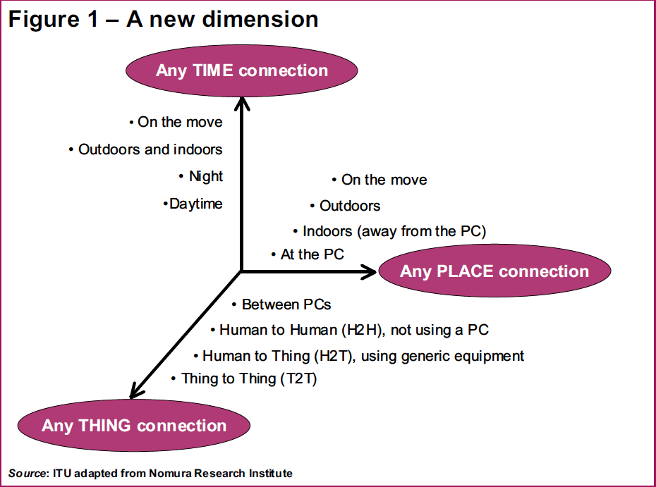
What’s the Internet of Things
From any time ,any place connectivity for anyone, we will now have connectivity for anything!
Notes:
An interesting conclusion

Slide 7
What’s the Internet of Things
Characteristics
Ambient
Intelligence
Flexible
Structure
Event
Driven
Internet of Things
Semantic
Sharing
Complex Access Technologies
Notes:
This part need to be discussed again
AI: the autonomous and intelligent entities will act in full interoperability & will be able to auto-organize themselves depending on the context, circumstances or environment.
ED is to design the scheme depending on the need
FS means that hundreds and thousands of nodes will be disable and will be set to run.
CAT means that there’s several kinds of media such as vehicle stone that they need different access technologies.
SS is the machine can rend and send by themselves. No need to tell humanbeings

Slide 8
Why Internet of Things
Dynamic control of industry and daily life
Improve the resource utilization ratio
Better relationship between human and nature
Forming an intellectual entity by integrating
human society and physical systems
Notes:
1 and 2 factors are about Resource Efficiency,
Energy conservation is a prerequisite for the Internet of Things. Therefore research producing new knowledge on how to develop more energy efficient electronics will influence the design of all electronics. Concept of energy harvesting will enable larger and larger portions of the consumed energy to be generated by ambient renewable sources available locally thus reducing the losses in long distance energy distribution.
Similar effects will be experienced by road transport and cars. Already today there are hybrid cars available harvesting the kinetic energy of the drive. This, in combination with better and more environmentally friendly energy storage in the future will make electrical vehicles achieve longer range and become more attractive alternatives.
Abundant sensory information will enable unprecedented energy optimised control. Climate control is the most energy consuming activity in modern buildings. The house could adjust the room temperatures according to the personal preferences of those in the room, and avoid heating or cooling rooms excessively without benefits to the inhabitants.
3. is the pollution and disaster avoidance
4.

Slide 9
Why Internet of Things (ii)
Flexible configuration, P&P…
Universal transport & internetworking
Accessibility & Usability?
Acts as technologies integrator
Notes:
1 and 2 factors are about Resource Efficiency,
Energy conservation is a prerequisite for the Internet of Things. Therefore research producing new knowledge on how to develop more energy efficient electronics will influence the design of all electronics. Concept of energy harvesting will enable larger and larger portions of the consumed energy to be generated by ambient renewable sources available locally thus reducing the losses in long distance energy distribution.
Similar effects will be experienced by road transport and cars. Already today there are hybrid cars available harvesting the kinetic energy of the drive. This, in combination with better and more environmentally friendly energy storage in the future will make electrical vehicles achieve longer range and become more attractive alternatives.
Abundant sensory information will enable unprecedented energy optimised control. Climate control is the most energy consuming activity in modern buildings. The house could adjust the room temperatures according to the personal preferences of those in the room, and avoid heating or cooling rooms excessively without benefits to the inhabitants.
3. is the pollution and disaster avoidance
4.

Slide 10
The application of IoT(1)
Regional Office
Biosensor taken by people
House
Network
Equipment in public place
Transportation Vehicle
Virtual Environment
Notes:
Application area should be divided by that two

Slide 11
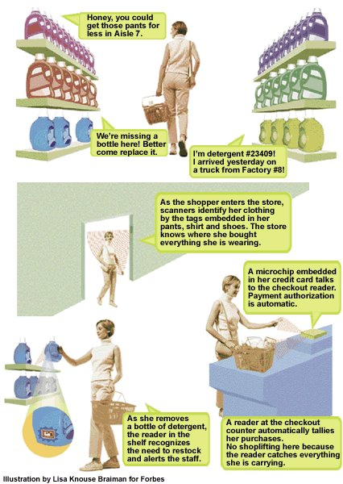
The application of IoT(2)
Scenario: shopping
(2) When shopping in the market, the goods will introduce themselves.
(1) When entering the doors, scanners will identify the tags on her clothing.
(4) When paying for the goods, the microchip of the credit card will communicate with checkout reader.
(3) When moving the goods, the reader will tell the staff to put a new one.

Slide 12
The application of IoT(3)
Scenario: Food Nutrition
Notes:
Europe is traditionally spoiled with excellent food and wine where the quest for the perfect taste has been ongoing for centuries. French law pioneered the idea of protecting produce of a limited geographical origin, and similar laws have since been established in many European countries. Traceable identities will help the consumers to verify the origins of the products and help Europe to preserve agricultural diversity and rural lifestyles.
traceability may provide market feedback to the producers in a sector where the production is often planned well in advance according to wholesale dealers’ prediction of the market for certain produce and the producers’ flexibility is limited by long term contracts and politically decided production subsidies. The recent global food crisis highlighted that the feedback mechanisms in food market do not work as well as in other commodity markets making the food availability oscillate between periods of overproduction and shortage. All the major food producers in the world could have augmented their production had they only seen the increase demand earlier.

Slide 13
The application of IoT(4)
Scenario: Health Care
Notes:
New efficient diagnostics combined with nanotechnology enabled lab-on-a-chip technologies open a complete range of novel opportunities for new treatments and prevention of serious diseases. In-vivo equipment will assist in drug dosage closer to the affected organs thus reducing the amount of reagents needed and diminish the risk of adverse effects. It is an established fact that several serious common illnesses like breast cancer, cardio-vascular diseases and Alzheimer's disease have genetic components. It is also known that successful treatment depends on early detection.
Biodegradable materials will offer the possibility to place temporary sensors and lab-on-a-chip equipment on the patient, or in the patient. Temperature and humidity can be measured inside a cast to prevent skin problems. Antigens may be detected on transplanted organs to help prevent rejection. Intelligent micro-robots may be guided to bring drugs to the infected areas by ex-vivo remote guidance, and assist in the diagnosis providing located measurements of vital parameters.
Furthermore, this new sort of personal medical equipment will enable the patient to stay longer and safer at home since the equipment itself can alarm the hospital in case of critical situations, or the patient can be relieved from the hassle of routine checks when there is nothing wrong. Medical research will advance on data from patients living normal lives and not like guinea pigs in hospitals. Telemedicine may replace costly travel and reduce patient stress.

Slide 14
The application of IoT(5)
Scenario: Intelligent Home
Notes:
Maintaining a comfort temperature and heating of water are the most energy consuming tasks of the house with huge potentials for energy conservation, and as a consequence a significant positive impact on the environment. This is further discussed under environmental aspects and resource efficiency below
There will be robots taking care of the house, performing routine works such as cleaning or maintenance. These will collaborate autonomously with the house sensors, and the house control. The intelligent appliances will collaborate to conserve energy, and to signal need for new supplies of food, detergents, maintenance, etc. Some of which may be satisfied automatically by the maintenance robot. This will take away some of today’s tedious housekeeping activities.

Slide 15
The application of IoT(6)
Scenario: Transportation
Notes:
When there is a queue, the first cars may tell the cars behind if there is an accident or just too much traffic, and this will eventually make intelligent navigation systems re-plan the route of cars programmed to go down already saturated roads. The cars may help the driver to keep safe distance to the car in front, and may refuse dangerous actions like speeding if the weather conditions are unsafe or overtaking if the oncoming car goes too fast. The cars can go by autopilot on highways reducing the risk of fatigue related accidents.
Cars will also be able to maintain themselves, calling for the appropriate service based on the self diagnosis of the problem and ensuring that the right replacement parts are in stock. The car will plan the time of service according to the diaries and preferences of the usual driver to minimise the petulance of their lives, and make sure that there is a substitute car available if there would be a need for it.

Slide 16
State of the Art of IoT
Enabling Technologies
RFID
Sensor
Smart Tech
Nano Tech
To identify and track the data of things
To collect and process the data to detect the changes in the physical status of things
To enhance the power of the network by devolving processing capabilities to different part of the network.
To make the smaller and smaller things have the ability to connect and interact.
Notes:
More than four several technologies
machine-to-machine interfaces and protocols of electronic communication
microcontrollers
wireless communication
RFID
Energy harvesting technologies
sensor technology
Location technology
Software
IPv6

Slide 17
Sensor technology
The ability to detect changes in the physical status of things is essential for recording changes in the environment.
Wireless sensor technology play a pivotal role in bridging the gap between the physical and virtual worlds, and enabling things to respond to changes in their physical environment. Sensors collect data from their environment, generating information and raising awareness about context.
Example: sensors in an electronic jacket can collect information about changes in external temperature and the parameters of the jacket can be adjusted accordingly
Notes:
Add more sensor technology

Slide 18
State of the Art of IoT
Research groups
1
2
3
MIT Auto-ID Lab & EPC Global.
Stanford University
Georgia Institute of Technology
Cambridge Univ
EPFL & ETH Zurich
Information and Communication Systems Research Group
Chemnitz University of Technology
VSR Group
Nokia
SAP
IBM
GOOGLE
AMBIENT
Metro Group
Siemens
Sun
Cisco
GE
Notes:
Need to improve about the research groups and projects

Slide 19
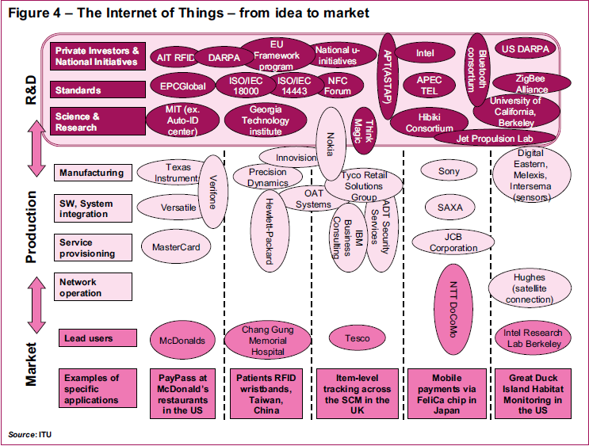
State of the Art of IoT
Notes:
Diagram of the whole system of IoT business and R&D
Add some content of economic system of IoT and what it related with other part of society

Slide 20
The challenge of IoT
Total challenge of IOT
Technological Standardization in most areas are still remain fragmented.
managing and fostering rapid innovation is a challenge for governments
privacy and security
Absence of governance
Notes:
Absence of governance is the first main challenge
One major barrier for the widespread adoption of the Internet of Things technology is the absence of governance. Without an impartial governing authority it will be impossible to have a truly global “Internet of Things”, accepted by states, companies, trade organizations and the common people. Today there is not a unique universal numbering scheme as just described: PCglobal and the Ubiquitous Networking Lab propose two different, non-
compatible ways of identifying objects, and there is the risk to have them competing in the coming future over the global market. There is also the need of keeping governance as generic as possible, as having one authority per application field will certainly lead to overlap, confusion and competition between standards. Objects can have different identities in different contexts so having multiple authorities would create a kind of multi-homing, which can lead to disastrous results.

Slide 21




The challenge of IoT
How to convincing users that the IoT technology will
protect their data and privacy when tracking
Potential Solutions
Legal & Regulatory
Technical Control
Market
Self-regulation
Social Ethic
Notes:
Privacy and security
In order to have a widespread adoption of any object identification system, there is a need to have a technically sound solution to guarantee privacy and the security of the customers. While in many cases the security has been done as an add-on feature, it is the feeling that the public acceptance for the IoT will happen only when the strong security and privacy solution are in place. This could be hybrid security mechanisms that for example combine hardware security with key diversification to deliver superior security that makes attacks significantly more difficult or even impossible. The selection of ssecurity features and mechanisms will continue to be determined by the impact on business processes; and trade-offs will be made between chip size, cost, functionality, interoperability, security, and privacy. The security and privacy issues should be addressed by the forthcoming standards which must define different security features to provide confidentiality, integrity, or availability services. There are also a range of issues related to the identity of people. These must be dealt with in politics and legislation, and they are of crucial importance for the efficient public administrations of the future. Although many of the proposed technologies are based on RFID or smart systems, they will not be discussed in this report whose focus is on objects and things and the related technological and application challenges.

Slide 22
The challenge of IoT
Solution of the main challenge: Education and Information
Notes:
Solution of the main challenge: Education and Information
Education and Information are central aspects for the success of the upcoming IoT. As discussed in previous sections, privacy concerns about the misuse of information are high, and final users do not clearly see the advantages of the widespread adoption of this technology. Therefore, education about the potential use and clear benefits of the IoT must be carried out, together with significant advances in privacy enhancement technologies. As well, information to the users about the presence of RFID tags, the reading range, the kind of data contained in the devices and in the back system, and the use of those, must be clear and easily available.

Slide 23
The challenge of IoT
Solution of the main challenge: Legislation
Notes:
Second solution to challenge Legislation
When moving towards the Internet of Things it is mandatory that policy keeps up with technology so that citizens gain confidence in the new technology and will accept to live in the “Internet of Things”. When bar codes were introduced they received public uprising and rejection. Attempts to introduce electronic health cards have been unsuccessful based on public fear for information misuse. RFID tags have seen a similar resistance leading to tags that can be erased when clients leave the supermarket, or temporarily disabled, or just be read by trusted readers. In addition to research of current concerns, it is important to engage the wider public in a political debate and dialogue about the Internet of Things. People’s momentarily context and roles can determine their attitudes towards new technology: as an example, an employee will resist his boss' access to his or her mailbox while the same person may demand the same insight into the mailboxes of subordinates.

Slide 24
The challenge of IoT
Limitation of IoT
Notes:
Add more limitation of IoT
Use RFID tags to detect is a lower level of IoT, IoT still cannot reach a status that tracking things by detecting its original attributions like microwave it generates, and also the limitation of the range should not be neglected.
The application of IoT in extreme situations are still not tested, for example in the outer space and very hot or very cold area.

Slide 25
Future of IOT
Traffic Issue
Production
Daily Life
Logistics
Resource & Power Control
Retailing
Notes:
Different areas that would be implement, this part should be improved

Slide 26
Future of IOT
Notes:
Open issue

Slide 27
Future of IOT
Notes:
Technology trends

Slide 28
Thank You !

